Slide 1

17th KASH CONFERENCE 2027 · SUB-THEME 7: MATERNAL, CHILD & ADOLESCENT HEALTH
Hearts at Risk
RSV test positivity among hospitalised children with cardiac disease in Kenya — surveillance evidence to guide targeted RSV prevention
278 children under five with cardiac disease admitted with SARI at four sentinel hospitals, 2024–2026
Steve Charo
Centre for Global Health Research, Kenya Medical Research Institute (KEMRI), Kisumu
Notes:
Good morning. This is a story about a small group of children who carry a big risk: infants with heart disease admitted with severe acute respiratory illness. The practical question behind it is who should be first in line as RSV prevention products reach Africa.

Slide 2
The children in this study: 278 children under five with cardiac disease, admitted with SARI
278
7 months
40/278
children aged 0–59 months with cardiac disease admitted with SARI, 18 with heart failure
median age (IQR 4–12); 75/278 had malnutrition
died in hospital (14.4%), and 108/278 needed ICU or acute care
Every analysis that follows is restricted to these 278 children. The question is how much of their burden RSV accounts for, and which of them test positive.
Denominators differ where a field was not recorded. Source: KEMRI/CGHR SARI surveillance, children aged 0–59 months, Jan 2024–Jul 2026.
Notes:
These are the children: 279 admitted with SARI who had cardiac disease, mostly infants — median age seven months. One in seven did not survive the admission. Everything that follows stays inside this group; children without cardiac disease are not part of the analysis.

Slide 3




RSV prevention is arriving, but doses will be limited — who should be protected first?
RSV is the leading cause of severe lower respiratory infection in infants worldwide
PRIMARY QUESTION
Maternal RSV vaccines and long-acting monoclonal antibodies are becoming available
How often do children with cardiac disease admitted with SARI test positive for RSV, and which of them do?
With limited supply and budgets, countries need local evidence on which children to prioritise
Outcome: RSV RT-PCR result. Population: children with cardiac disease only.
Notes:
New RSV products are arriving, but no country can protect every child at once. Our primary question is framed the way a surveillance dataset can answer it: is a positive RSV test more likely in children with heart disease? The outcome variable is the RSV result; the exposure is cardiac disease.

Slide 4



Who was studied: children under five with cardiac disease
Records in the SARI/ILI surveillance dataset
n = 42,431
Eligibility
Cardiac disease, aged 0–59 months (median 7 months, IQR 4–12), admitted with SARI, RSV RT-PCR result available
Excluded 38,804:
Not tested for RSV (testing began 2024)
RSV RT-PCR result available (testing from 2024)
n = 3,627
Excluded 73:
Aged ≥5 years
Aged 0–59 months (<5 years)
n = 3,554
Excluded 145:
Not admitted to hospital
Sites and period
Kenyatta National, Mombasa, Siaya and Nyeri; January 2024 – July 2026
Admitted to hospital (admission date recorded)
n = 3,409
Excluded 20:
Outpatient ILI case definition
Met an inpatient SARI case definition
n = 3,389
Excluded 23:
Site contributing <50 children
Cardiac disease
Chronic cardiac disease at enrolment or discharge, or a cardiac diagnosis in the notes (congenital, rheumatic, cardiomyopathy, CCF)
Enrolled at a sentinel site contributing ≥50 children
n = 3,366
Excluded 3,088:
No cardiac disease
Analysis population: children with cardiac disease
n = 278
Analysis
Bivariate screen (likelihood-ratio test), then logistic regression with RSV result as the dependent variable: variables with p < 0.20 plus age and sex a priori
RSV-positive
55/278 (19.8%)
RSV-negative
223/278 (80.2%)
Primary outcome: RSV RT-PCR result
Heart failure in 18 of the 278 children
Figure 1. Participant flow; each box shows previous n − excluded = this n. Exclusions: 73 aged ≥5 years, 145 never admitted, 20 outpatient ILI, 23 from a small site, 3,088 without cardiac disease.
Notes:
Here is the flow, with every exclusion and its reason so the counts reconcile. Of 42,431 records, 3,627 had an RSV result; after keeping admitted children under 18 at the four sentinel sites, 3,379 remained, and the 279 with cardiac disease are our analysis population. Children without cardiac disease are excluded at that last step.

Slide 5
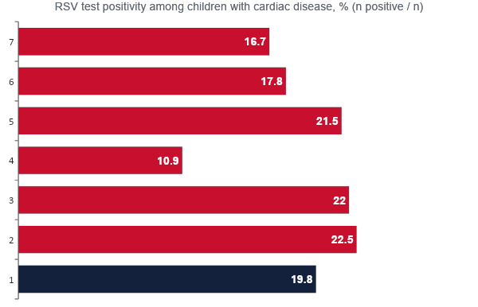
RSV was found in 1 in 5 of these children — and the burden sits in the first year of life
19.8%
of children with cardiac disease tested positive (55/278; 95% CI 15.5–24.9)
Infants under 12 months: 47/211 positive (22.3%), against 8/67 (11.9%) at 12 months and over.
Children aged 0–59 months with cardiac disease. 95% CI by the Wilson method. Subgroups with very few children (24–59 months, n = 3; Nyeri, Siaya) are in Table 2 with their wide intervals.
Notes:
About one in five of these children tested positive for RSV. Within the group, positivity is concentrated in infancy: roughly 22% under a year, falling to about 11% in the second year. Sex, site and heart failure made little difference.

Slide 6
What predicted a positive RSV test? Age — and only age
Candidate predictor | Crude OR (95% CI) | Bivariate p | In model? | Adjusted OR (95% CI)
Age group (whole variable) | — | 0.115 | Yes | —
6–11 months (vs <6 months) | 0.89 (0.46–1.72) |  |  | 0.87 (0.45–1.68)
≥12 months (vs <6 months) | 0.43 (0.18–1.01) |  |  | 0.43 (0.18–1.02)
Male sex (vs female) | 1.27 (0.69–2.31) | 0.441 | Yes (a priori) | 1.23 (0.67–2.26)
Sentinel site (4 sites) | — | 0.922 | No | —
Heart failure (vs other cardiac) | 0.76 (0.21–2.72) | 0.670 | No | —
Malnutrition | 1.09 (0.57–2.10) | 0.798 | No | —
Hospitalised in previous 12 months | 1.09 (0.60–1.97) | 0.784 | No | —
HOW VARIABLES WERE CHOSEN
Dependent variable: RSV result (positive = 1)
Each candidate screened alone (likelihood-ratio test)
Entered the model if p < 0.20, plus age and sex a priori
Final model: age group + sex; n = 267, 55 positive
Binary logistic regression among children with cardiac disease (Table 3). Reference categories: age <6 months, female. Site, heart failure, malnutrition and prior hospitalisation did not reach p < 0.20 and were not adjusted for. Children aged ≥12 months: aOR 0.43 (0.18–1.02; p = 0.055).
Notes:
This is the primary analysis. We screened each candidate on its own, then adjusted for those reaching p below 0.20, keeping age and sex regardless. Only age qualified. Children of 12 months and older had less than half the odds of testing positive compared with infants under six months. Site, heart failure, malnutrition and prior hospitalisation showed nothing.

Slide 7
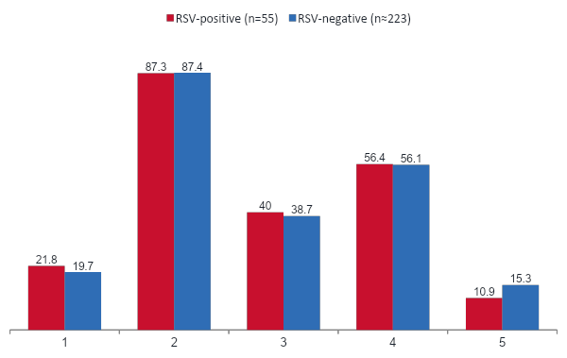
Secondary: RSV-positive and RSV-negative admissions looked alike
Adjusted OR, RSV-positive vs RSV-negative
Any severe marker
1.05 (0.57–1.91)
ICU / acute care
1.10 (0.60–2.03)
Death
0.69 (0.27–1.76)
Median stay
14 vs 15 days (+1; −3 to +3)
Roles reversed: RSV is the exposure, the admission is the outcome. All met the SARI definition, so ‡ these markers (SpO₂ <90%, ICU/acute care, ventilation or death) grade severity within an already-severe group. Adjusted for age group and sex; denominators vary (n = 55 and 222–223).
Notes:
Our secondary analysis reverses the roles and asks what the admission looked like. A caveat the reviewers rightly raised: every child here met the SARI case definition, so all were severe by definition. What we can compare are markers within that group — hypoxaemia, intensive care, death — and they were almost identical by RSV status.

Slide 8


Each RSV admission kept a child with cardiac disease in hospital for about two weeks
1,201
14
hospital bed-days used by the 55 RSV-positive admissions
median bed-days per admission (mean 22; a few very long stays)
22/55
5,342
RSV-positive children admitted to ICU or acute care
bed-days used by all 278 children with cardiac disease
Bed-days = date of outcome minus date of admission for children discharged alive or who died. ICU/acute care day counts were incompletely recorded, so they are not totalled.
Notes:
The economics. Those 55 RSV admissions used about 1,200 bed-days — a median of two weeks each — and 22 of the 55 needed intensive or acute care. In a referral hospital that is real capacity.

Slide 9

The lesson: prevention aimed at young infants is where the gain is
RSV is common in this group
→
And these admissions are costly
→
So prevention is the lever
1 in 5 tested positive, and 22% of infants under 12 months against 12% of older children
14% of the 278 children died, and a stay ran about two weeks
Positivity peaks in infancy — the window maternal vaccines and monoclonals cover
Notes:
Putting it together: RSV is no more common in these children, but it costs them more, and positivity peaks in the first six months of life — exactly the window that maternal vaccination and monoclonal antibodies cover.

Slide 10
From evidence to impact: three actions for Kenya
Prioritise
Infants with cardiac disease, and pregnant women where maternal vaccination is used, in the first wave of any RSV prevention rollout — they gain the most per infection averted.
1
Track
Track cardiac-disease in routine SARI surveillance, so positivity and outcomes in this group can be measured.
2
Invest
Run a prospective study with post-discharge follow-up and costing, and confirm the case definitions and diagnoses used here.
3
Notes:
Three actions: prioritise these infants, track them in surveillance, and build the investment case with a prospective study.

Slide 11


What these data can, and cannot, tell us
Strengths
Limitations
Multi-site surveillance with standardised forms
RSV confirmed by real-time RT-PCR
Restricted to children under five with cardiac disease
Variable selection and full models reported
Small numbers: 55 RSV-positive, 18 with heart failure
Cardiac disease partly identified from clinical free text
All children met the SARI definition, so severity is graded, not present vs absent
No follow-up after discharge; case-definition codes to be confirmed
Notes:
Being honest about the evidence: small numbers, cardiac disease partly from clinical notes, severity graded rather than present or absent because all these children were severe, and no follow-up after discharge.

Slide 12
Protect the youngest hearts from RSV
1 in 5 tested positive · 22% of infants under 12 months · about two weeks in hospital per admission
Thank you
To the children and families, the sentinel hospital teams, and the KEMRI/CGHR surveillance and laboratory staff.
Notes:
To close: one in five of these admissions was RSV, concentrated in the first year of life, in children who can least afford it. Preventing RSV in young infants is a measurable way to turn this evidence into impact. Thank you.

